Slide 1
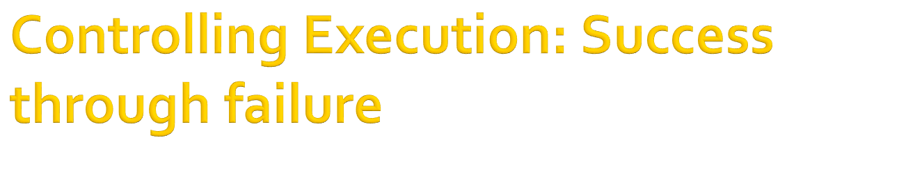
Chapter 7

Slide 2

the built-in fail predicate is used in prolog
  to force a rule to fail under certain condition
  Whenever this predicates invoked , the goal being proved immediately fails, and backtracking is initiated.
the fail predicate
  has no argument
  always evaluates to false.

Slide 3

Goal: go
False
Goal
go:-
test,
write(“You will never get here”).
test:-
fail.
go:-
write(“You will get here”),
test.
test:-
fail.
Goal: go
You will get here
False
Goal

Slide 4

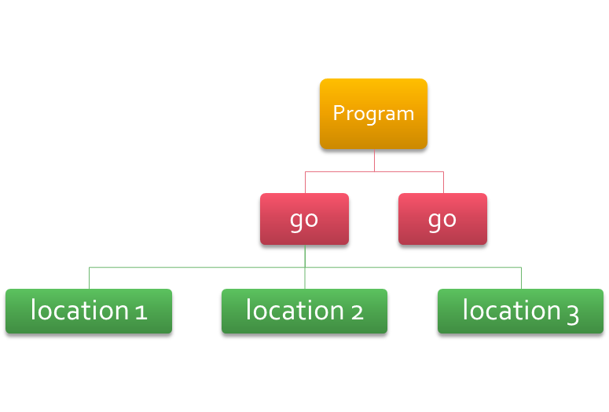
predicates
  location(string,string)
  go
  clauses
  go:-
  location(City,State),
  writef(“%-10 %2\n”, City ,State),
  fail.
  go.
  location(“Jackson”,”MS”).
  location(“Washington”,”DC”).
  location(“Raleigh”,”NC”).
Goal: go
Jackson MS
Washington DC
Raleigh NC
Goal

Slide 5
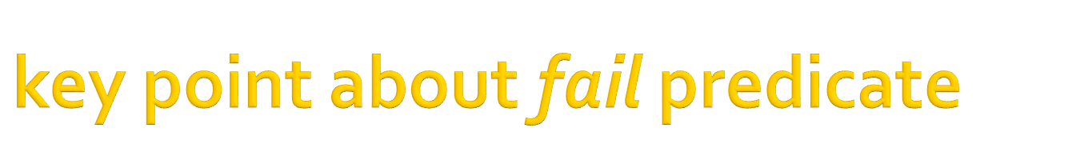
the order of go clause is very important. There order defines an algorithm or procedure
the 2nd go clause is an important part of the definition. It terminates the backtracking and is called terminating condition.
the variables in the clause lose their binding every time the rule fails.
Prolog remembers the bindings it has already tried

Slide 6

predicates
  location(string,string)
  go
  clauses
  go:-
  location(City,State),
  check_state(State),
  writef(“%-10 %2\n”,City,State),
  fail.
  go.
  location ( “Jackson”, ”MS” ).
  location ( “Washington”, ”DC” ).
  location ( “Raleigh”, ”NC” ).
  check_state(“DC”):-
  !, fail;
  check_state(_);
Goal: go
Jackson MS
Raleigh NC
Goal

Slide 7
End of Slide

